Slide 1
Evaluating Home Renovation Opportunities in King County, WA
Analysis by Brian Bentson

Slide 2
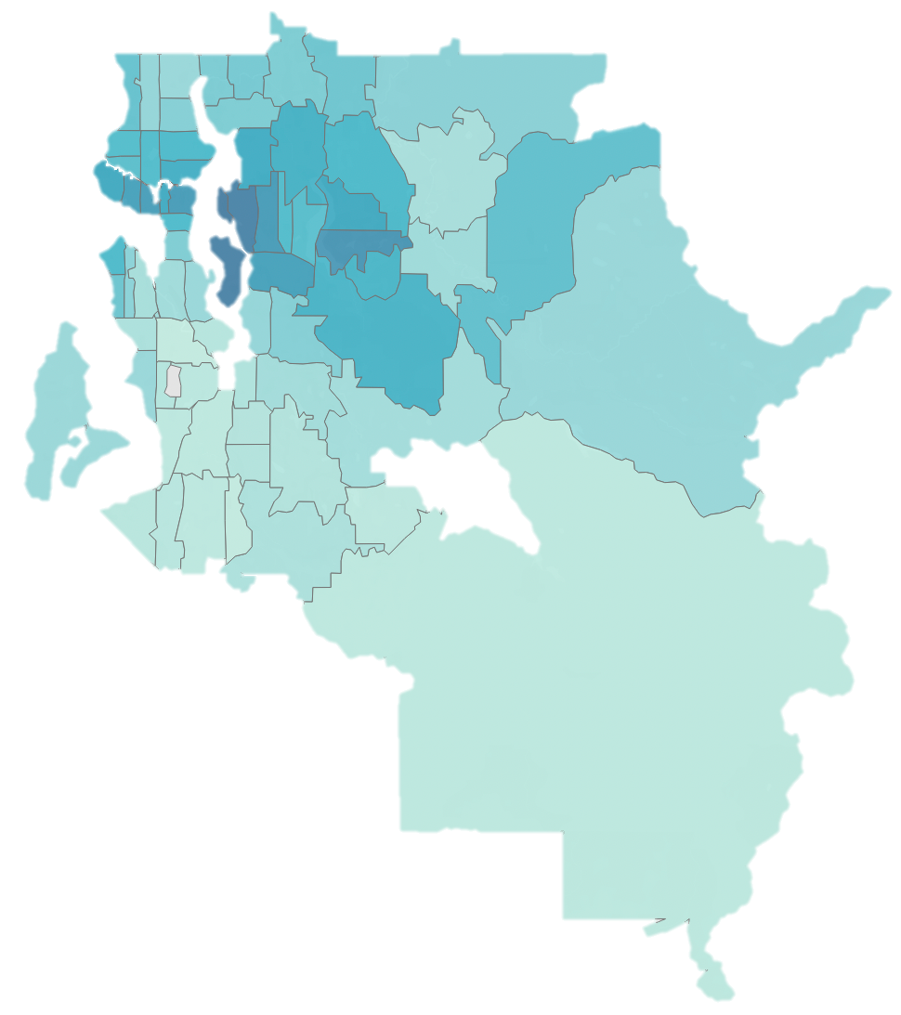
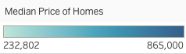
Analysis Overview
Emphasized features of a home which can be renovated that improve home value
~15,000 home sales analyzed from 2014 and 2015
Small and Midsize homes with less than 6 bedrooms
Linear Regression Modeling to understand how housing features affect price
Seattle

Slide 3
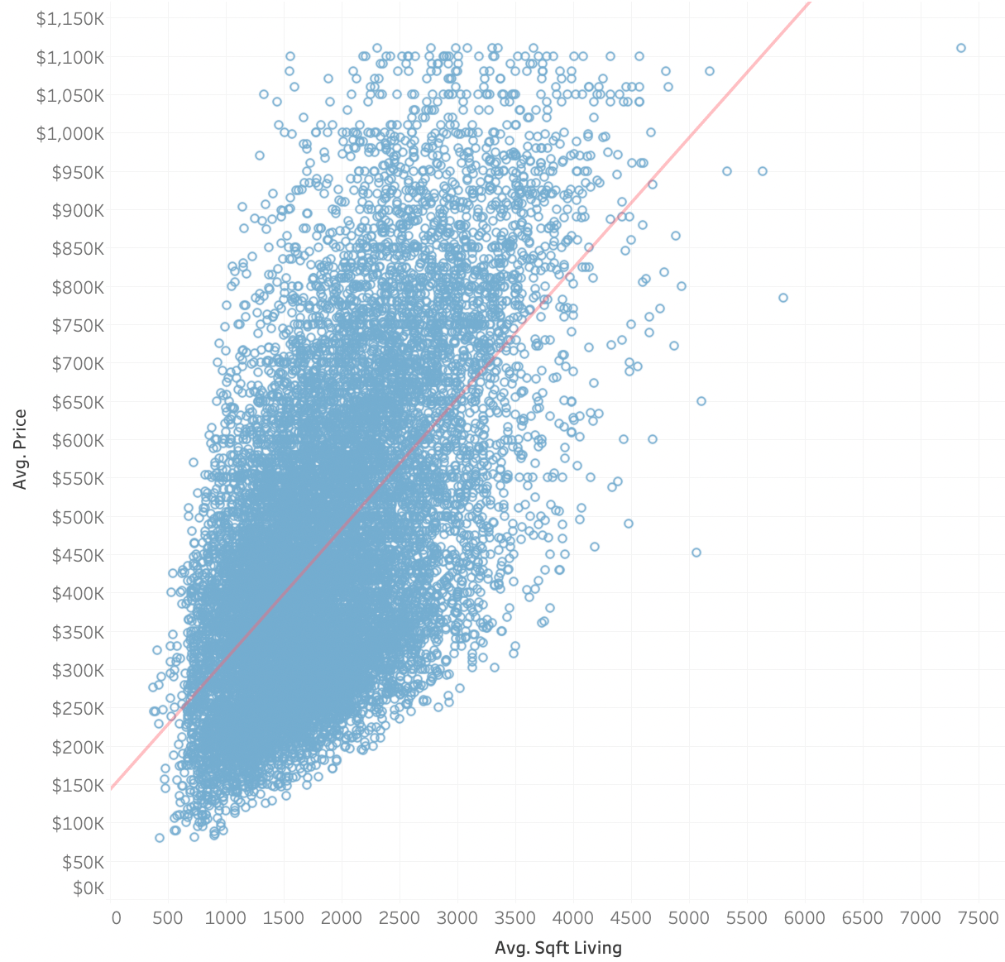
Best Fit Modeling of Home Price
Selected optimal variables that correlate with Price
Focused analysis on center of the data
Model can explain 83% of the variation in price
Mixture of controllable and uncontrollable variables

Slide 4

Biggest Drivers of Home Price
Total Sqft
POSITIVE
View
Condition
Renovated
Waterfront
Floors
NEGATIVE
Grade
Home Age
Bathrooms
Lot Sqft
Bedrooms
Basement
Total Square Feet dominates
Grade of construction is important
Bathrooms improve price
Basement offers a unique opportunity to increase square footage

Slide 5
Overview of Renovation Options
DO’s
DON’Ts
Item | Potential Value
Add a Bathroom | $15,000/bathroom
Add Square Feet | $120/sqft
Finish a Basement with > 350 sqft | $18,000 +$120/sqft over 350
Use High Grade Construction | $21,000 for level 9
Item | Potential Value
Add a Bedroom | -$45,000
Add a Floor | -$8000
Finish a Basement with < 350 sqft | -$24,000

Slide 6

The Grade of Construction Matters
Below Average Grades
Above Average Grades
Pay for above average construction quality and design (9-12)
Not worth it to get the absolute best grade (13)
Average construction grade is 7
POSITIVE
9
10
11
12
NEGATIVE
4
5
6
7
8
CONSTRUCTION GRADE LEVEL

Slide 7
Recommendation: Finish a Basement
with 700 sqft and High-Grade Construction
+$21,000
$81,000
Having a basement effects home price negatively by itself
Model predicts an additional $120 to the homes value for every additional square foot
Median basement size in the area is 700 sqft
+$84,000
Having a Basement
$0
Grade 9 Construction
Total Value Added
-$24,000
Adding 700 sqft

Slide 8
Recommendation: Add a Full-Size Bathroom
with 60 sqft and High-Grade Construction
+$21,000
$43,200
Adding a bathroom positively impacts home value by itself
Full bathroom adds more square feet than a half bathroom
Use Grade 9 construction
+$7,200
+$15,000
$0
Adding a Bathroom
Adding 60
sqft
Grade 9 Construction
Total Value Added

Slide 9
Conclusion
Finish the basement with over 350 sqft
Average basement size is 700 sqft in the area, finishing a 700 sqft basement yields $81,000
Add a full bathroom (~60 sqft)
$43,200 to the value of a home
Use high grade construction materials
Use a grade between 9-12 (above average of 7)
Notes:
The estimates for full bathroom square feet from an online search for ”average full bathroom size”.

Slide 10
Thank you
Questions?

